Slide 1
Analysis of Body Fat Predictors
Presented by Samuel Van Gorden

Slide 2
Introduction

Slide 3
Motivation
Discover which if any variables from data set are good predictors of body fat percentage
Quantify exactly how well any potential models perform when compared with one another
Decide which models are best suited for particular applications
Determine if there is an approach to measuring body fat that minimizes cost (financial, time, invasiveness)

Slide 4
Explanation of Data
Comes from South Dakota School of Mines and Technology
252 total observations (all men)
Variables are percent body fat, body density, age, weight (lbs), height (in), neck, chest, abdomen, hip, thigh, knee, ankle, biceps (extended), forearm, and wrist circumferences (cm)
Use percent body fat as response and rest as predictors

Slide 5
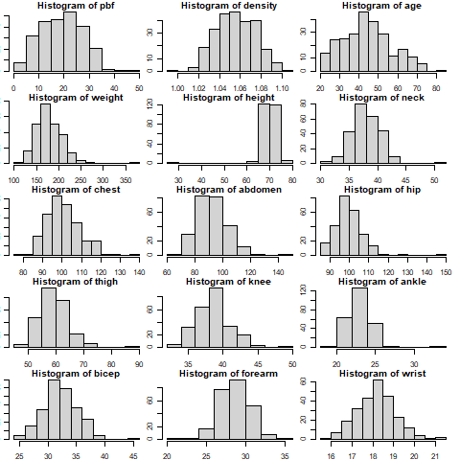
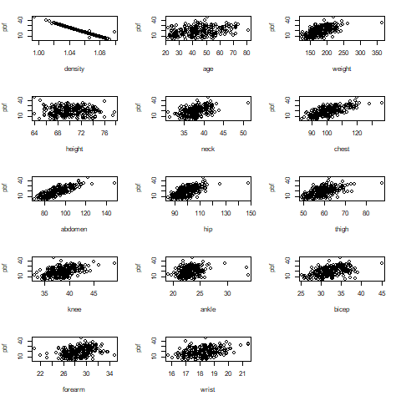
Variable Distributions and Response vs Predictors

Slide 6
Data Cleaning
Remove obvious bad data
0.0 percent body fat
Any rows with NAs
Fit density-only model and full model without density and remove points with large Cook’s distance
Influential points
Remove three points at a time until Cook’s distances no longer stand out for any particular points

Slide 7
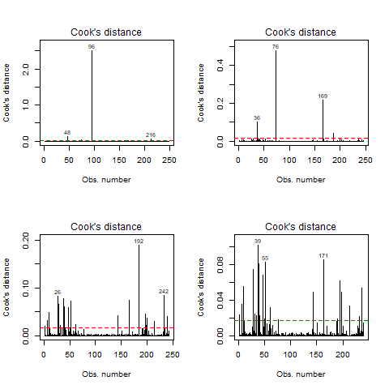
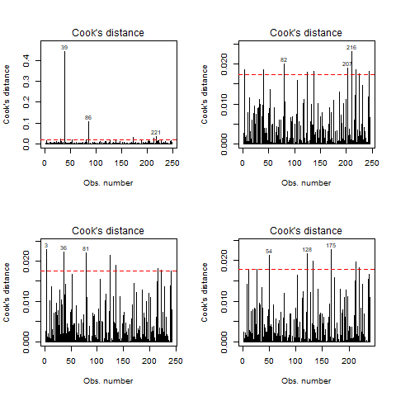

Slide 8
Model Building

Slide 9
Density vs Non-Density Models
One simple linear model with density as sole predictor
Density costly to measure, see if other model works as well
A few other models based on correlation between response variable and between other variables
Forearm and ankle
Least multicollinearity, most correlation with response
Bad model (low R-squared, ankle not significant)
All but hip and thigh
Hip and thigh highest multicollinearity
Adj R-squared = 0.7262
Only abdomen and wrist sig at < 0.1

Slide 10
Density vs Non-Density Models
Reduced additive model - age, neck, abdomen, hip, thigh, and wrist
Determined by taking variables significant at < 0.05 from full (without density) model
Adj R-squared = 0.7309, lower complexity (6 predictors)
Abdomen only model
Probably best single predictor of body fat outside of density
Adj R-squared = 0.6753

Slide 11
Checking Assumptions - Density
Residuals vs Fitted shows nonlinearity, Normal Q-Q shows non-normality of errors
Box-Cox method shows transformation of pbf by ~0.93 may help
Perform transformation - seems to resolve issue

Slide 12
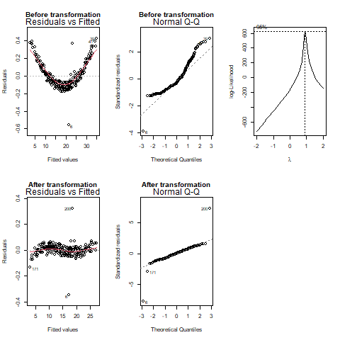

Slide 13
Checking Assumptions - No Density
Residuals vs Fitted shows roughly linear and constant error variance and Normal Q-Q shows roughly normal errors
No transformations needed

Slide 14
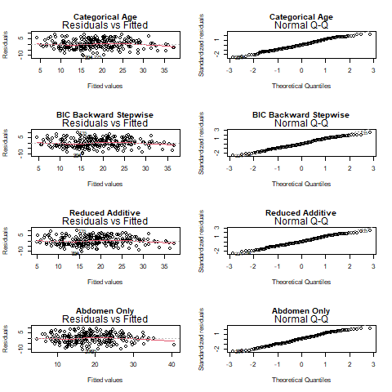

Slide 15
AIC/BIC Criterion
Utilize stepAIC (greedy algorithm) to find locally minimized AIC/BIC
Lowest Adj R-squared from AIC - forward selection
Age, neck, abdomen, hip, thigh, forearm, wrist, and weight
Adj R-squared = 0.7347
Lowest Adj R-squared from BIC - backward selection/stepwise (same model)
Age, abdomen, hip, thigh, and wrist
Adj R-squared = 0.7262

Slide 16
Converted Categorical Age/Height
Converted age to categorical with three categories (young, middle aged, old)
Converted height to categorical with two categories (short, tall)
Fit/Refit several models - best was forward selection model from previous step with categorical age
Adj R-squared = 0.732
Highest of any non-density model so far

Slide 17
MSEE Minimization
Density-only model
Squared bias = 3959, model variance = 0.003909, MSEE = 3959
Non-density models
Three with lower bias than density model
BIC, categorical, reduced additive with 3918, 3770, 3836, respectively
All have higher model variance
Abdomen-only lowest with 39.718
MSEE lower than density model for categorical and reduced additive models (3934 and 3951, respectively)

Slide 18
Training/Validation
Split data sets (density, no density, categorical) into even (120 observations) training and validation sets
Refit each model with training data sets and then input validation data in each refit model
Calculate MSPE for each model by summing the square of the difference between each fitted value and the actual validation data point (pbf) and dividing by number of training set observations (120)
Density-only model has lowest MSPE (15.076) but the rest are not far behind (categorical model with 17.084, rest around 20)
Expected better prediction from density-only model due to low model variance

Slide 19
Conclusions

Slide 20
Best Models
Density-only should be excellent for prediction, but MSPE shows it’s not too much better than the rest
Categorical age model excels with respect to MSEE, MSPE, and the fact that it does not require difficult-to-obtain density measurements
Abdomen-only is probably best simple linear model aside from density-only
Reduced additive and BIC backward stepwise models perform well but have considerably higher model variance than density-only

Slide 21
Next Steps
Try converting other variables (like weight) to categorical due to success with categorical age model
Collect data on women
Obtain models for women-only data, fit women-only data on models we obtained in this project, fit new models including data with men and women, possibly using gender as a categorical variable
More advanced types of regression - ridge regression or principal component regression

Slide 22
Thank you!

